Slide 1
Applications of STACKS

Slide 2
Applications of STACKS
Stacks can be used to reverse a sequence. For example, if a string ”Computers” is entered by the user the stack can be used to create and display the reverse string “sretupmoC” as follows.
The program simply pushes all of the characters of the string into the stack. Then it pops and display until the stack is empty.

Slide 3
PALINDROME EXAMPLE
The strings where the reading from the reverse and forward directions give the same word are called a palindrome. For example, the string ”radar” is an example for palindrome.
Among many other techniques stack can be used to determine if a string is a palindrome or not. This is achieved by pushing all the letters of a given word into stack and checking if the letters popped are the same as the letter of the string.

Slide 4
Removal of Recursion
The function which call itself (In function body ) again and again is known as recursive function . This function will call itself as long as the condition is satisfied.
This recursion can be removed by two ways:
1. Through Iteration.
2. Through Stack

Slide 5
A simple program of factorial through recursion
long factorial(int);
int main()
{
int n;
long f;
printf("Enter an integer to find factorial\n");
scanf("%d", &n);
if (n < 0)
printf("Negative integers are not allowed.\n");
else
{
f = factorial(n);
printf("%d! = %ld\n", n, f);
}
return 0;
} long factorial(int n)
{
if (n == 0)
return 1;
else
return(n * factorial(n-1));
}

Slide 6
A simple program of factorial through iteration
long factorial(int);
int main()
{
int n;
long f;
printf("Enter an integer to find factorial\n");
scanf("%d", &n);
if (n < 0)
printf("Negative integers are not allowed.\n");
else
{
f = factorial(n);
printf("%d! = %ld\n", n, f);
}
return 0;
} long factorial(int n)
{
int c;
long result = 1;
for (c = 1; c <= n; c++)
result = result * c;
return result;
}

Slide 7
Factorial of a program using stack
#include<stdio.h>
#include<string.h>
#define MAX 100
// push method
int push(int *s, int top, int ele)
{
int i;
if (top >= MAX)
{
printf("\nStack Overflow");
}
else
{
s[++top] = ele;
}
return top;}
//pop method
int pop(int *a, int *top)
{
if ((*top) >= 0)
{
(*top) = (*top) - 1;
return a[(*top) + 1];
}
else
{
printf("Stack underflow\n");
return 0;
}
}

Slide 8
// personally, i believe that declaring TOP and S here is bad practice
int main()
{
int n;
int i; // loop variable
int ans = 1 ; // stroes the final answer
int TOP = -1;
int s[MAX]; // the stack
printf("\nEnter number: ");
scanf("%d",&n);
if(n<=0)
{
printf("\nThe number can not be less than 0");
}
else
{
for(i = n ; i >0 ; i--)
{
TOP = push(s,TOP, i);
}
// now pop all the elements one by one
// multiply them with the answer variable
while(TOP>=0)
{
ans = ans * pop(s,&TOP);
}
printf("\nFactorail is %d\n",ans);
}
// getch(); // will not work on linux
return 0;
}

Slide 9
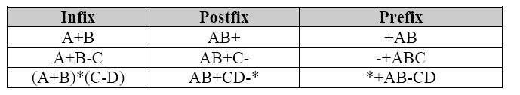
POLISH Notation: INFIX, POSTFIX AND PREFIX NOTATIONS
Infix, Postfix and Prefix notations are used in many calculators.
The easiest way to implement the Postfix and Prefix operations is to use stack.
Infix and prefix notations can be converted to postfix notation using stack.
The reason why postfix notation is preferred is that you don’t need any parenthesis and there is no precision problem.

Slide 10
POSTFIX
In Postfix notation the expression is scanned from left to right.
When a number is seen it is pushed onto the stack;
when an operator is seen the operator is applied to the two numbers popped from the stack and the result is pushed back to the stack.

Slide 11
Example
Postfix notation P : 5, 6, 2, +, *, 12, 4, /, -)
Symbol Scanned | STACK
5 | 5
6 | 5, 6
(3) 2 | 5, 6, 2
(4) + | 5, 8
(5) * | 40
(6) 12 | 40, 12
(7) 4 | 40, 12, 4
(8) / | 40, 3
(9) - | 37
(10) )

Slide 12
Infix expressions into postfix Expressions
Algorithm :
Suppose Q is an arithmetic Expressions written in Infix notation. This algorithm finds the equivalent postfix expression P.
Push “(“ onto STACK, and add “)” to the end of Q.
Scan Q from left to right and repeat steps 3 to 6 for each element of Q until the STACK is empty.
If an operand is encountered, add it to P.
If a left parenthesis is encountered, push it onto STACK.
If an operator is encountered, then :
(a) Repeatedly pop from STACK and add to P each operator (on the top of STACK) which has the same precedence as or higher precedence than
(b) Add to STACK
[End of if structure]
If a right parenthesis is encountered, then :
(a) Repeatedly pop from STACK and add to P each operator (on the top of STACK) until a left parenthesis is encountered
(b) Remove the left parenthesis
[End of if structure]
[End of step 2 loop]
Exit.
X
X
X

Slide 13
postfix of A * (B + C * D) + E is A B C D * + * E +
current symbol operator stack postfix string
A ( A
* (* A
( (* ( A
4 B (* ( A B
+ (* ( + A B
6 C (* ( + A B C
7 * (* ( + * A B C
D (* ( + * A B C D
) ( * A B C D * +
10 + (+ A B C D * + *
11 E (+ A B C D * + * E
12 ) A B C D * + * E +

Slide 14
Infix to Prefix conversion
Algorithm :
Suppose Q is an arithmetic Expressions written in Infix notation. This algorithm finds the equivalent postfix expression P.
Reverse the given expression to get Q’.
Scan Q’ from left to right and repeat steps 3 to 6 for each element of Q until the STACK is empty.
If an operand is encountered, add it to P.
If a right parenthesis is encountered, push it onto STACK.
If an operator is encountered, then :
(a) Repeatedly pop from STACK and add to P each operator (on the top of STACK) which has the same precedence as or higher precedence than
(b) Add to STACK
[End of if structure]
If a left parenthesis is encountered, then :
(a) Repeatedly pop from STACK and add to P each operator (on the top of STACK) until a right parenthesis is encountered
(b) Remove the right parenthesis
[End of if structure]
[End of step 2 loop]
In last reverse the P. Exit.
X
X
X

Slide 15
(A * (B + C * D) + E) reverse Q’= )E+)D*C+B(*A(
current symbol operator stack prefix string (P)
E ) E
+ )+ E
) )+ ) E
4 D )+) ED
* )+)* E D
6 C )+)* EDC
7 + )+) + EDC*
8 B )+) + EDC*B
9 ( )+ EDC*B+
10 * )+ * EDC*B+
11 A )+* EDC*B+A
( EDC*B+A*+
P`= +* A + B *CDE

Slide 16
Postfix to prefix conversion
Scan Q from left to right and apply step 2 & 3 repeatedly on each symbol of Q.
If an operand is scanned, add it to stack.
If an operator is scanned then
(i) POP the topmost element and store it in a temp1.
(ii) POP the next topmost element and store it in a temp2.
(iiI) Create a temporary string contains the operator and popped operand in prefix order. Operand_temp2_temp1
(iv) Push the string on the top of stack
Exit.

Slide 17
42^3*3-84/11+/+
Character scanned 4 2 ^ 3 * 3 - 8 4 / 1 1 + / + | Stack 4 4,2 ^42 ^42,3 *^423 *^423,3 -*^4233 -*^4233,8 -*^4233,8,4 -*^4233,/84 -*^4233,/84,1 -*^4233,/84,1,1 -*^4233,/84,+11 -*^4233,//84+11 +-*^4233//48+11

Slide 18
Checking for Balanced Braces
A stack can be used to verify whether a program contains balanced braces
  An example of balanced braces
    abc{defg{ijk}{l{mn}}op}qr
  An example of unbalanced braces
    abc{def}}{ghij{kl m

Slide 19
Checking for Balanced Braces
Requirements for balanced braces
  Each time you encounter a “}”, it matches an already encountered “{”
  When you reach the end of the string, you have matched each “{”

Slide 20
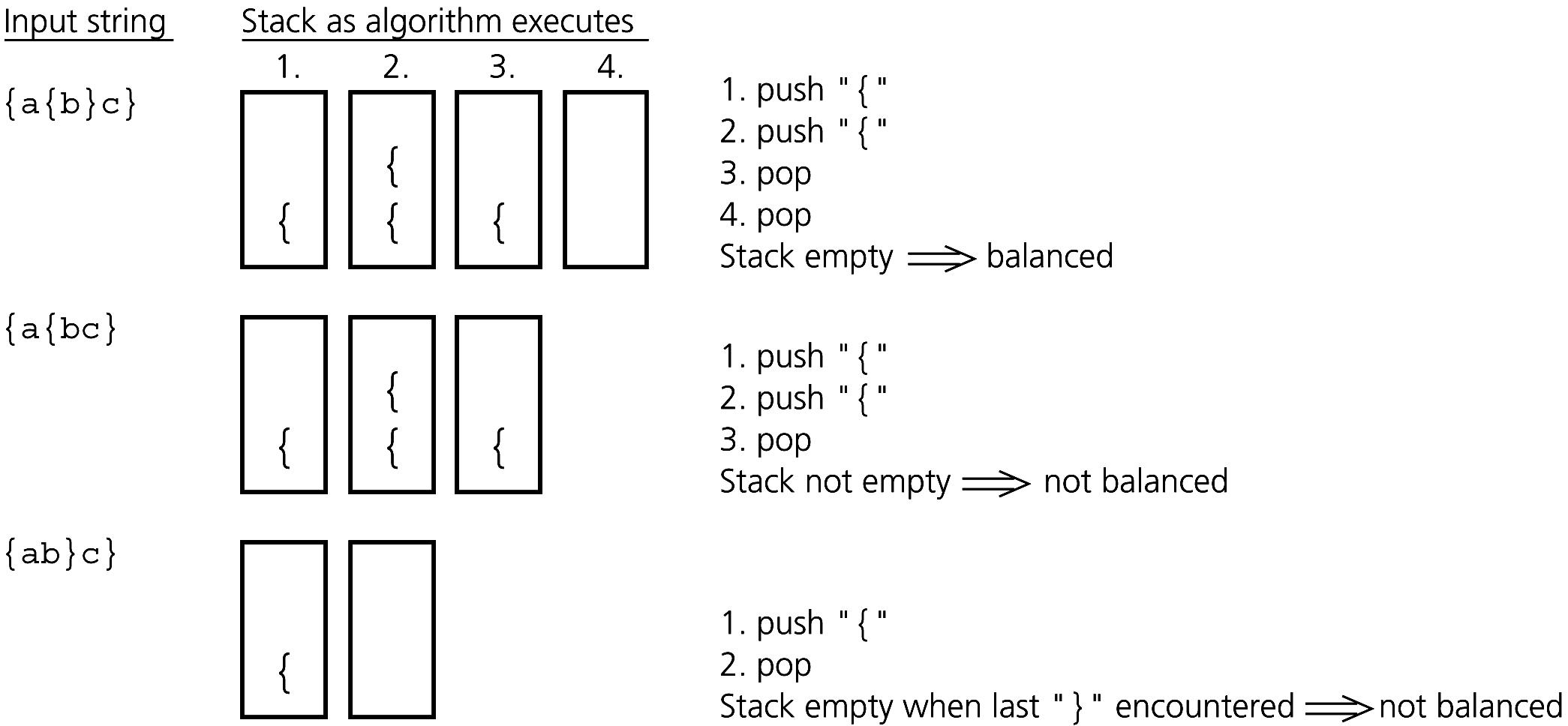
Checking for Balanced Braces
Traces of the algorithm that checks for balanced braces

Slide 21
Stack Applications: Converting Decimal to Binary:
Converting Decimal to Binary: Consider the following pseudocode
  Read (number)
  Loop (number > 0)
  1) digit = number modulo 2
  2) print (digit)
  3) number = number / 2
  The problem with this code is that it will print the binary
  number backwards. (ex: 19 becomes 11001000 instead of 00010011. )
  To remedy this problem, instead of printing the digit right away,
  we can push it onto the stack.
  Then after the number is done being converted, we
  pop the digit out of the stack and print it.

Slide 22
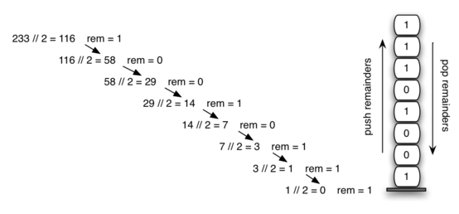
problem.
Decimal-to-Binary Conversion

Slide 23
void main()
{
stack s;
int num;
s.top=-1;
printf("\nEnter decimal number:");
scanf("%d",&num);
while((num!=0))
{
push(&s,num%2);
num=num/2;
}

Slide 24
printf("\n");
while(s->top==-1)
{ num=pop(&s);
printf("%d",num);
}
}

Slide 25
C Program to Convert Infix to Postfix Expression using Stack
#include<stdio.h>
char stack[20];
int top = -1;
void push(char x)
{
stack[++top] = x;
}
char pop()
{
if(top == -1)
return -1;
else
return stack[top--];
}
int priority(char x)
{
if(x == '(')
return 0;
if(x == '+' || x == '-')
return 1;
if(x == '*' || x == '/')
return 2;
}

Slide 26
main()
{
char exp[20];
char *e, x;
printf("Enter the expression :: ");
scanf("%s",exp);
e = exp;
while(*e != '\0')
{
if(isalnum(*e))
printf("%c",*e);
else if(*e == '(')
push(*e);
else if(*e == ')')
{
while((x = pop()) != '(')
printf("%c", x);
}
else
{
while(priority(stack[top]) >= priority(*e))
printf("%c",pop());
push(*e);
}
e++;
}
while(top != -1)
{
printf("%c",pop());
}
}

